Slide 1
Lecture: 05
Z-Transform and Discrete-time LTI Systems
By
Afrin Ahmed

Slide 2
Z-Transform
Z-transform, like the Laplace transform, is an essential mathematical tool for the design, analysis and monitoring of systems.
Z-transform converts a discrete-time signal into a complex frequency domain representation. That is, it can be considered as a discrete-time equivalent of the Laplace transform.
The Laplace transform converts integrodifferential equations into algebraic equations. In a similar manner, the z-transform converts difference equations into algebraic equations, thereby simplifying the analysis of discrete-time systems.

Slide 3
Z-Transform
A working knowledge of the z-transform is essential to the study of digital filters and systems.
Using z-transform, the description of a system in the z-domain can reveal valuable insight into the system behavior and stability.
Analysis of system can also be more convenient as differentiation and integration operations are performed through multiplication and division by the frequency variable respectively.
Furthermore the transient and the steady state characteristics of a system can be predicted by analyzing the roots of the z-transform, the so-called poles and zeros of a system.
Signals and systems use two forms of z-transform:
Unilateral (one-sided) z-transform
Bilateral (two-sided) z-transform
If the type of z-transform is not specified, it can be assumed that you should calculate the unilateral version.
Notes:
Poles and Zeros of a transfer function are the frequencies for which the value of the denominator (হর, নীচের টা) and numerator (লব, উপরের টা) of transfer function becomes zero respectively. The values of the poles and the zeros of a system determine whether the system is stable, and how well the system performs.
H(s)=N(s)/D(s)={(s-z1)(s-z2)(s-z3)}/{s-p1)(s-p2)(s-p3)
Here, considering N(s)=0, the roots of N(s) are called zeros z1, z2, z3. Considering (Ps)=0, the roots of P(s) are called poles p1, p2 and p3. System’s poles and zeros determine whether the system is stable, and how well the system performs.

Slide 4

Unilateral Z-Transform
For a general discrete-time signal x[n] defined for n>=0, its unilateral z-transform is carried out by taking the summation over only n>=0, i.e., from n=0 to ∞.
Given a general discrete-time signal x[n], i.e., x[0], x[1], x[2], x[3], x[4], …..
The unilateral z-transform of x[n], denoted by X(z), is defined by
The variable z is generally complex-valued and is expressed in polar form as z=re^{jΩ} (where r is the magnitude of z and Ω is the angle of z). We see that z-transform is a series involving powers of 1/z.
The x[n] and X(z) are said to form a z-transform pair denoted as

Slide 5
Bilateral Z-Transform
For a general discrete-time signal x[n], its bilateral z-transform is carried out by taking the summation in both sides- over n≥0 and n≤0, i.e., from n=-∞ to +∞.
Given a general discrete-time signal x[n], i.e.,
x[-∞],……., x[-4], x[-3], x[-2], x[-1], x[0], x[1], x[2], x[3], x[4], ….. X[+∞]
The bilateral z-transform of x[n], denoted by X(z), is defined by
Clearly, the unilateral z-transform differs from the bilateral transform in that the summation is carried over only n>=0.

Slide 6
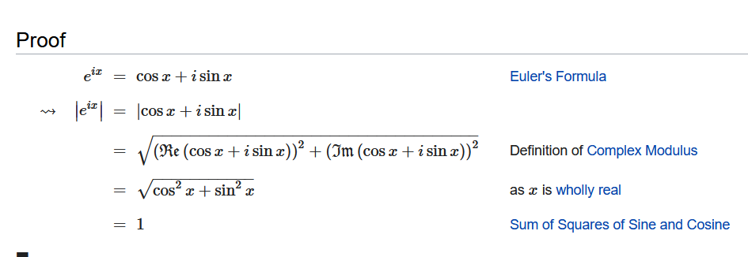
Modulus of Exponential of Imaginary Number is One

Slide 7
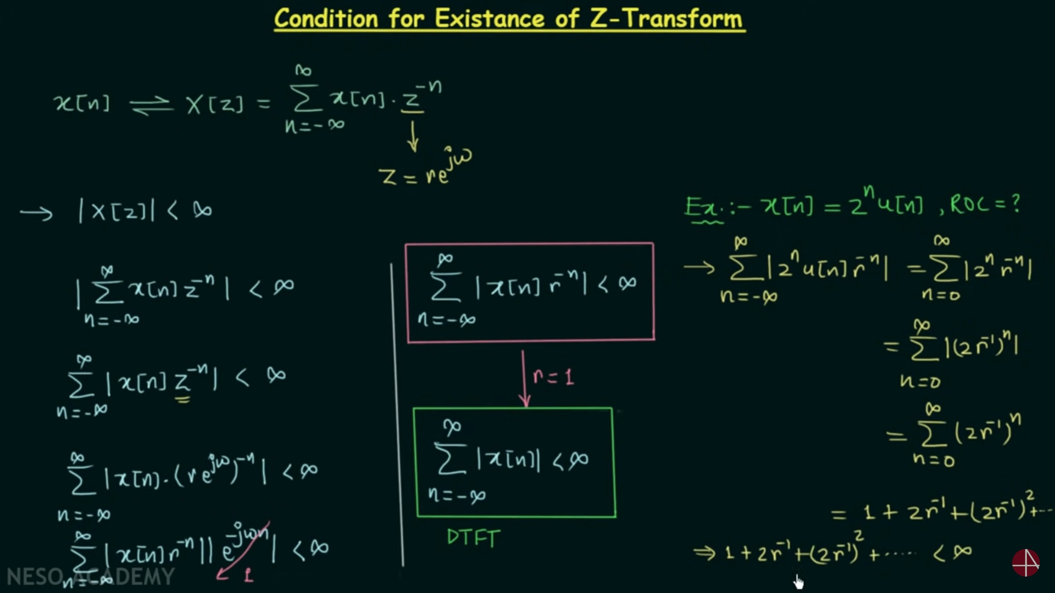

Slide 8
Z-Transform Condition Cont.
Here ‘r’ is the magnitude of Z
In order for the sum of the series to be less than infinity modulus of each term should be less than 1
|2r⁻¹ |< 1
= |2/r | < 1
= 2/r < 1
= 2 < r
= r > 2
This is the ROC value for given problem.

Slide 9
ROC of Z-Transform
Since the z-transform is an infinite power series, it exists only for those values of the variable z for which the series converges to a finite sum.
The ROC in z-transform is indicated as an circles contain unit circle (= circle with radius 1)
As in the case of the Laplace transform, the region of convergence (ROC) of X(z) is the set of all the values of z for which X(z) attains a finite computable value.
The ROC in general gives us an idea of the stability of a system.
To illustrate the z-transform and the associated ROC, let us consider some examples.

Slide 10




Region of Convergence (ROC)
Example-2:
Consider the discrete-time signal x[n]=a^{n}u[n] where a is real.
According to the definition, the z- transform of x[n] is:
For the convergence of X(z) we require that
Thus, the ROC is the range of values of z for which |az⁻¹|<1 or, equivalently, |z|>|a|. Then
Alternatively, by multiplying the numerator and denominator of eq. (4.9) by z, we may write X(z) as
From Infinite Geometric Series rule

Slide 11
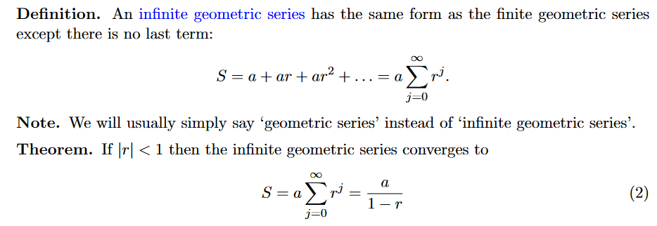

Slide 12
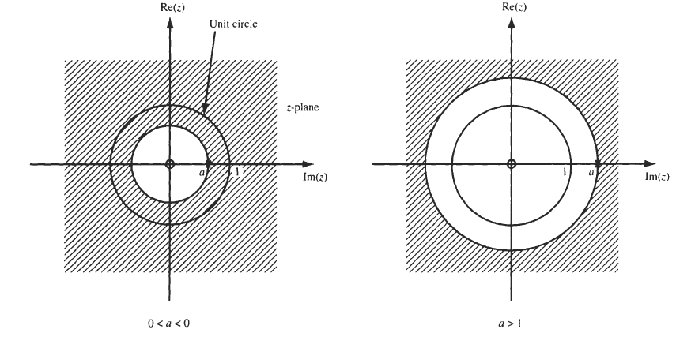
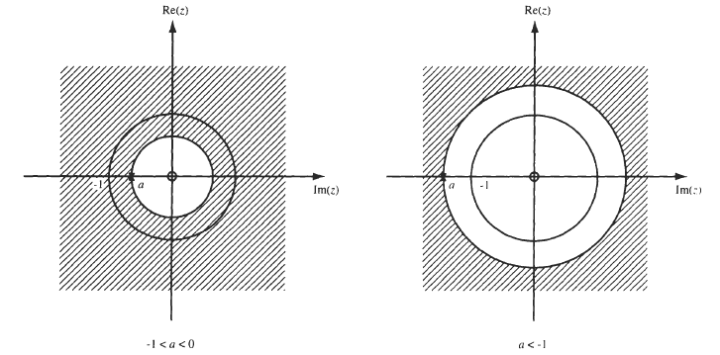
Region of Convergence (ROC)
From Eq. (4.10) we see that there is one zero at z = 0 and one pole at z =a.
The ROC and the pole-zero plot for this example are shown in Fig. 4-1.
Figure: ROC of the form lzl>lal

Slide 13
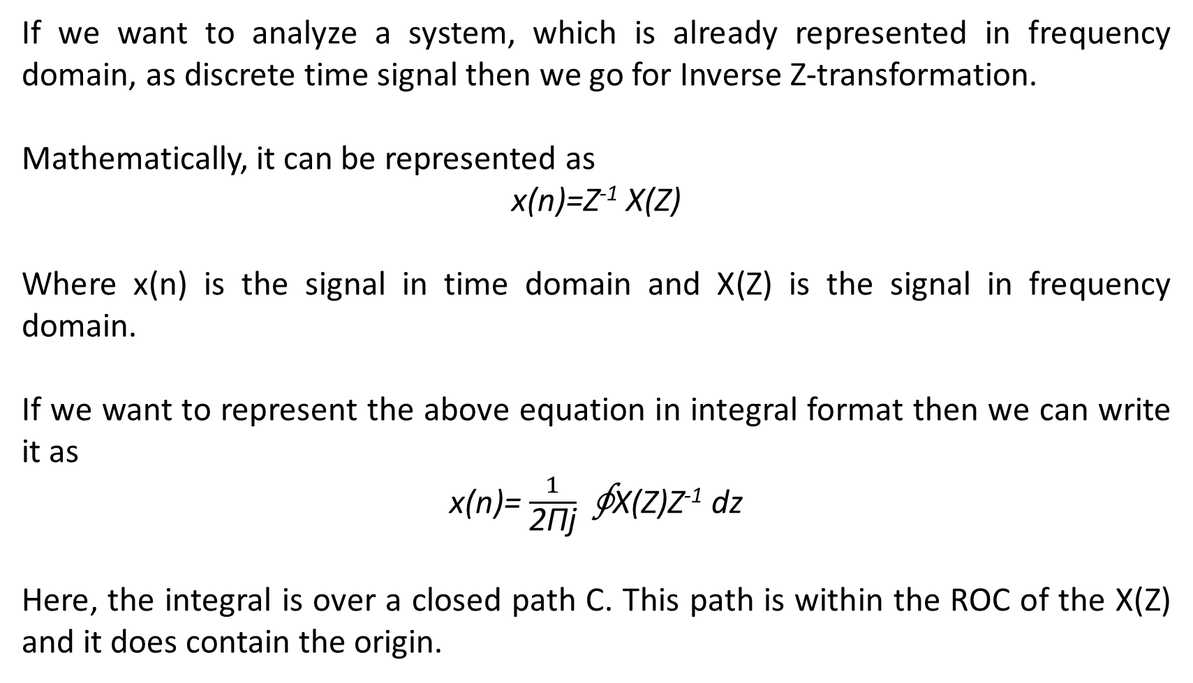
Inverse Z-Transform
If we want to analyze a system, which is already represented in frequency domain, as discrete time signal then we go for Inverse Z-transformation.
Mathematically, it can be represented as
x(n)=Z⁻¹ X(Z)
Where x(n) is the signal in time domain and X(Z) is the signal in frequency domain.
If we want to represent the above equation in integral format then we can write it as
x(n)= $\frac{1}{\text{2}\text{Πj}}$∮X(Z)Z⁻¹ dz
Here, the integral is over a closed path C. This path is within the ROC of the X(Z) and it does contain the origin.

Slide 14

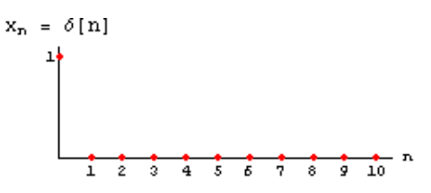
Z-Transform of Some Common Sequences
Here we compute the z-transforms of some common sequences often encountered in the study of LTI systems.
1. The z-transform of Unit Impulse Sequence δ[n]:
The unit impulse (or unit sample) sequence δ[n] is defined as
That is, δ[0]=1, δ[1]=0, δ[2]=0, δ[3]=0, δ[4]=0, …..
Then z-transform of δ[n] is

Slide 15
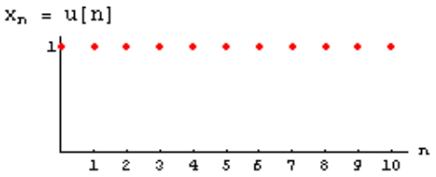


Z-Transform of Some Common Sequences
2. The z-transform of Unit Step Sequence u[n]:
The unit step sequence u[n] is defined as
That is, u[0]=1, u[1]=1, u[2]=1, u[3]=1, u[4]=1, …..
Then z-transform of u[n] is

Slide 16
Z-Transform of Some Common Sequences
3. The z-transform of x[n]=a^{n} (a is a real number):
According to the definition of z-transform of a^{n} is
Using this formula, we can calculate the z-transform of the function x[n]=(4/5)^{n} and x[n]=3^{n} by assuming that a=4/5 and a=3 respectively.

Slide 17
Z-Transform of Some Common Sequences
4. The z-transform of x[n]=e^{an} (a is a real number):
According to the definition of z-transform of e^{an} is
Using this formula, we can calculate the z-transform of the function x[n]=e^{3n} by assuming that a=3

Slide 18
Z-Transform of Some Common Sequences
5. The z-transform of x[n]=cos(an) (a is a real number):
According to the definition of z-transform of cos(an) is
Applying the formula of Z transform
Multiplying same nominator- denominator pair

Slide 19
Z-Transform of Some Common Sequences
According to the definition of z-transform of e^{an} is
Using this formula, we can calculate the z-transform of the function x[n]=cos(3n) by assuming that a=3

Slide 20








Z-Transform of Some Common Sequences
Function
Z-transform
ROC

Slide 21

Z-Transform Common Problems
X(n)
10
5
0
Transform the given information into Z domain or frequency domain
X(Z) = $\sum_{−∞}^{∞}{\left(x\left(n\right)z^{−n}\right)}$
= $\sum_{1}^{3}{\left(x\left(n\right)z^{−n}\right)}$
= n(1) z⁻¹ ₊ n(2) z⁻² ₊ n(3) z⁻³
= 1/z + 5/z² + 10/z³
ROC, When z = 0
X(0) = 1/0 + 5/0 + 10/0
= $∞$
Z = 1
X(1) = 1/1 + 5/1 + 10/1
= 16
Z = $∞$
X(1) = 1/$∞$ + 5/$∞$ + 10/$∞$
= 0
1 2 3 n

Slide 22
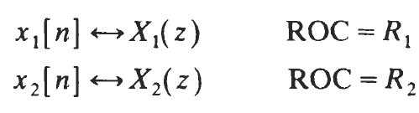
Properties of Z-Transform
The properties of the z-transform are closely parallel to those of the Laplace transform.
Linearity:
If
Then
Where a₁ and a₂ are arbitrary constants.

Slide 23
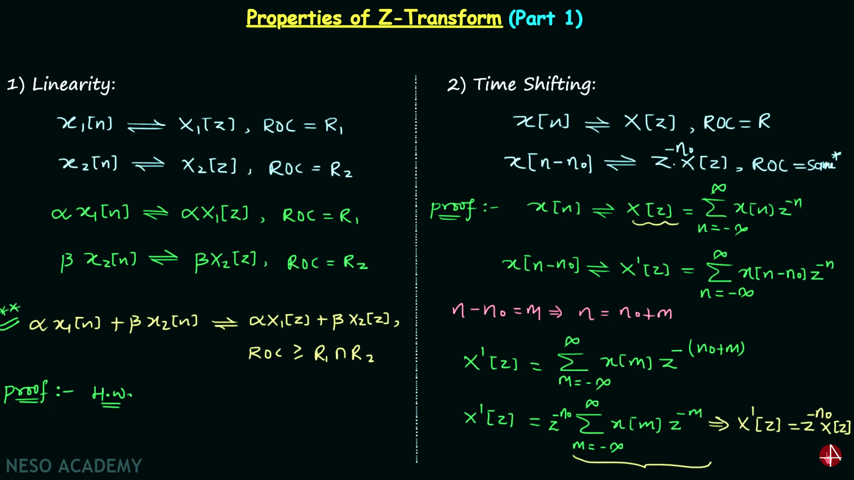

Slide 24


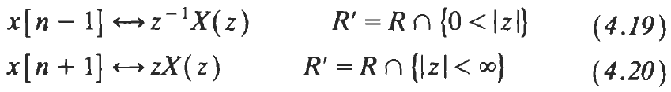
Properties of Z-Transform
Time Shifting:
If
Then
Special Case (when time shift is 1 delay or advance):
Because of these relationships [Eqs. (4.19) and (4.20)], z⁻¹ is often called the unit-delay operator and z is called the unit-advance operator.

Slide 25


Properties of Z-Transform
Time Reversal:
If
Then
Therefore, a pole (or zero) in X(z) at z=z_{k} moves to 1/z_{k} after time reversal.
The relationship R' = 1/R indicates the inversion of R, reflecting the fact that a right-sided sequence becomes left-sided if time-reversed, and vice versa.

Slide 26
Properties of Z-Transform
Convolution:
If
Then
Note that Σ^{n}_{k=-∞} x[k] is the discrete-time counterpart to integration in the time domain and is called the accumulation.

Slide 27



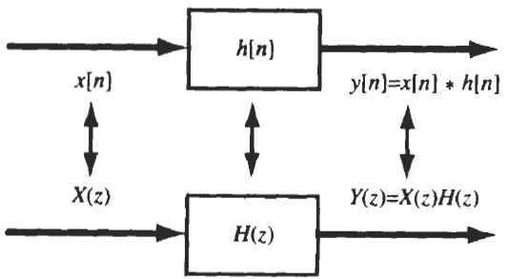
Z-Transform as System Function of Discrete-time LTI Systems
We know that the output y[n] of a discrete-time LTI system equals the convolution of the input x[n] with the impulse response h[n]. That is,
Applying the convolution property of z-transform to the above equation, we obtain
Therefore,
where Y(z),X(z),H(z) are the z-transforms of y[n], x[n], and h[n], respectively.
The z-transform H(z) of h[n] is referred to as the system function (or transfer function) of the system. It is a ratio of the z-transforms of the output y[n] and the input x[n].
The system function H(z) completely characterizes the system.
Figure below illustrates the relationship between impulse response and the system function.
Figure: Relationship between h(n) and H(z)

Slide 28
Thank You

